Slide 1
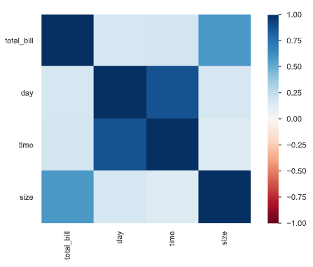
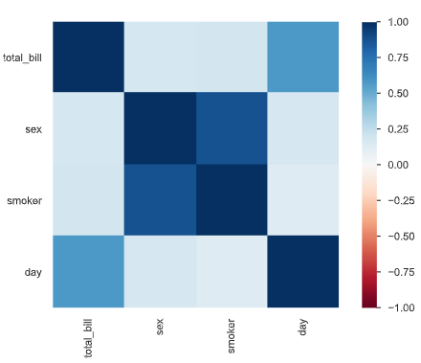
Target: ‘Tip’ without Mutate Variable
RFE
Regression Feature Selection

Slide 2
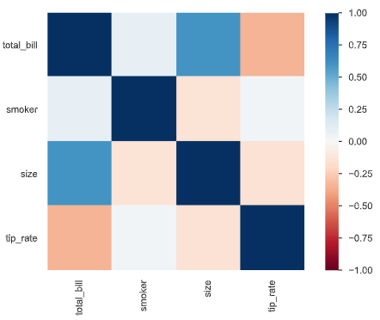
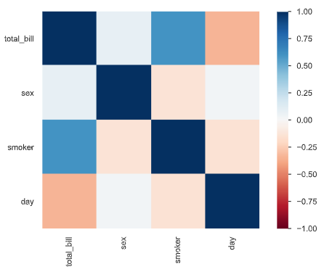
Target: ‘Tip’ with Mutate Variable: ‘Tip Rate’
RFE
Regression Feature Selection

Slide 3
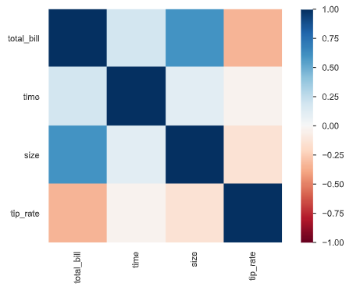
Normalization
RFE without Normalization
RFE with Normalization

Slide 4
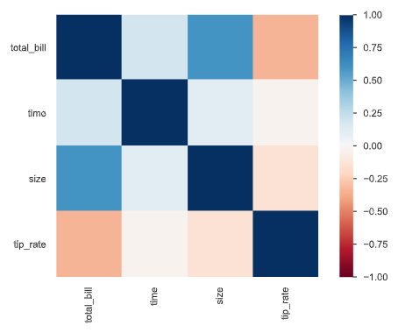
Standardization
RFE without Standardization
RFE with Standardization

